Slide 1
TOOL
Community Interview

Slide 2
IN A NUTSHELL…
Communities are a treasure trove of resources and knowledge. They also contain the hopes and aspirations of the people who live there. Local culture, beliefs and attitudes shape community life and well-being.
Understanding community in these ways will help you design new offers and will reveal the amazing assets upon which we can build.
What does this tool help you do?
Get started with this tool to collect information through conversations with members of the community about any topic or issue of interest.

Slide 3
ABOUT THIS TOOL
What was the tool developed for?
In collaboration with the Rooming House Project, we co-designed a process to better understand what life is like in Toronto’s Cabbagetown area. This tool was a key piece of a larger insight generation process aiming to understand the experiences of residents of, and the broader community surrounding, 22 rooming houses.
How did we use it?
Over two weeks, the team connected with: 16 businesses, 15 social agencies, 21 community residents, 3 parks, and 3 religious establishments in Cabbagetown.
We wanted to better understand the needs, resources and perspectives of the community to support the strengths and well-being of people living in rooming houses. We also gathered information about their relationships and connections in the community.
Upon synthesizing the data, the team developed an asset map (community resource guide) and 8 insights to support further planning.

Slide 4
HOW YOU CAN USE THIS TOOL
Edit the prompts in the community interview tool to make them yours.
Share the tool with those who will collect data and discuss any challenges they may have using it.
Use the development of your tool as a way to engage with other groups you wish to involve in your OHT (i.e. patients/clients and caregivers).

Slide 5
WHAT’S
INCLUDED
1
Question Guide Template: Learning from People
Question Guide Template:
Learning from Context
Prompt pad template
2
3

Slide 6
Learning from People
General Info
How long have you lived or worked in this community?
What do you like about living or working in this community, what don’t you like?
About the people
Describe the people you typically see?
Are they locals or do they come from further away?
Are there people in the community you know by name/face? If so, why and how do you develop a relationship with them?
About the community
What does community mean to you?
Where do people usually hangout in this community? Why?
Where do people avoid? Why?
How would you rate the safety of the surrounding community?
Have you seen changes in the community since you've moved or started working here?
What do you think about the current direction of the surrounding community?
About the population/topic/situation of interest
What do you think about the location of your home/business in relation to _____?
What do you think about the people who _____?
What are your experiences with people who ______?
Do you think that the people who _____ have an influence on your community (good or bad)?
What does an ideal community look like to you?
Ideas
Do you have any ideas as to how the local community can support the well-being of people who _____? What needs to change or continue?
Is there anyone in the community you recommend we talk to or place we should visit?

Slide 7
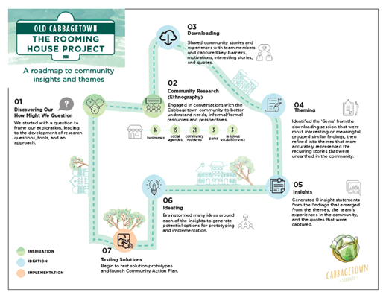
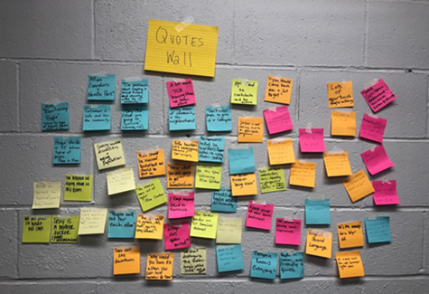
Learning from Context
Location (may include parks, cafés, recreation centre, library , etc.)
Record concrete details about what you see and hear, including quotes and impressions.
How does the community interact with the space?
Who uses this space? Why?
Experience: (pick an experience that reflects your topic or issue)
Map out the experience (customer journey)
How did you feel about the experience?
What was unexpected/challenging?

Slide 8
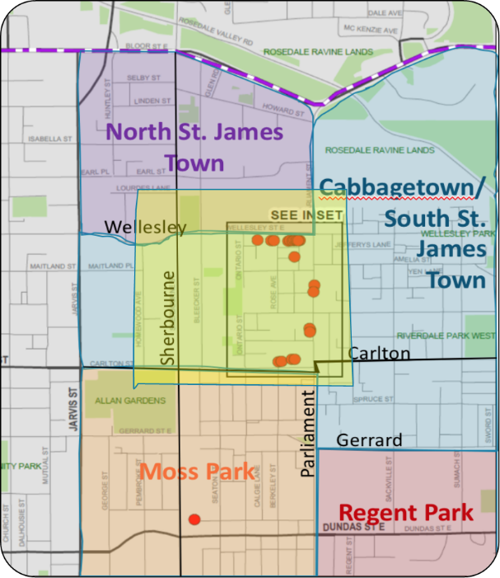
Note Pad # _______
Description: Style? Mood? Presentation?
Date:___________
Who am I talking to?
Where?
Get quotes!!
Connections/Supports & Resources: What and who are they in contact with?
Motivations/Interests: What matters to them? Where do you they hang out?
Thoughts on _____: Insights/Ideas/Opportunities?
Can I follow up with you?
When is a good time?
What is the best way to reach you?

