Slide 1
TOOL
Community Map Prototype and Database

Slide 2
IN A NUTSHELL
Communities are not blank canvasses. They are rich tapestries of resources, relationships and networks. Mapping is one way to uncover the existing resources in a community and to promote awareness to end users.
What does this tool help you do?
This tool allows you to visualize data collected about resources in your community. Making a map will help you easily digest the information and begin to see patterns in the availability, location, and type of resources in the community.

Slide 3
ABOUT THIS TOOL
What was the tool developed for?
Health Commons partnered with an Ontario Health Team to engage youth and providers in generating a list of local mental health and wellness resources. The OHT then conducted an environmental scan to find out more about each of these resources.
How did we use it?
We created a database to compile information about each resource. That information was then fed into a Google map as a way to quickly visualize the data.

Slide 4
HOW YOU CAN USE THIS TOOL
Use the template provided to save your own version of the data to your Google account.
Collect your own information and enter into the database. Modify the fields as needed.
Follow our instructions to connect your database to a Google Map.

Slide 5
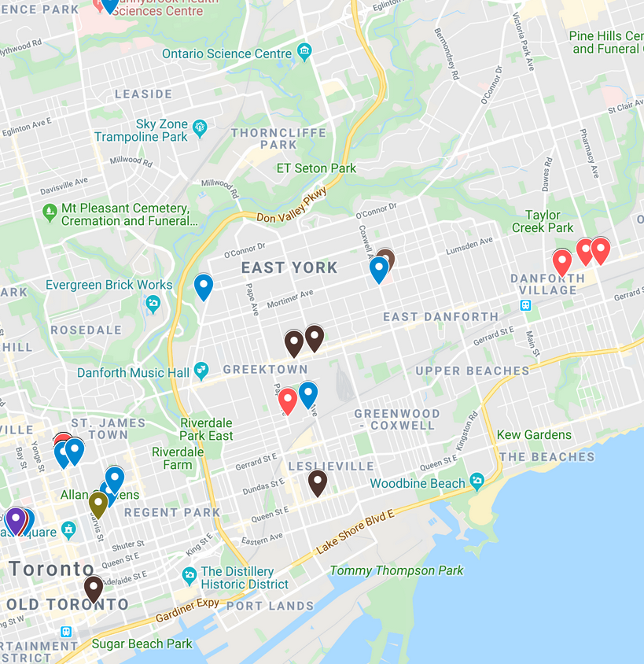
OUR EXAMPLE
Click here for example of database
Click here for example of map prototype
Contact us @ www.healthcommons.ca/contact
Notes:
Eg mental health working group -

Slide 6
MAKE YOUR OWN
Here’s how you can make your own database and link it to a Google map…
If you don’t already have one, make a Google account.
Download and upload our database template to your Google Drive to collect your own information. Modify the fields (columns) to make them work for you. Make sure the addresses are consistent – we suggest copy & pasting that information from a Google search.
From the Google Drive page, select ‘New’ > ‘More’ > ‘Google My Maps’
Under the ‘Untitled Layer’ section, select ‘Import’ and choose your database template.
Select ‘Address’ as the field with the mapping information and ‘Name’ as the title for your markers.
To be able to visualize the data by the fields (columns) of your database, you will need to add more layers from the same database file (i.e. repeat step 4). For the added layer, click on the paint roller icon and select ‘Style by data column’ and select the field (column) you’d like to filter on. Our example has filters for Type of Service and Specific Sub-Population Focus.
Contact us @ www.healthcommons.ca/contact
Notes:
Eg mental health working group -

