Slide 1
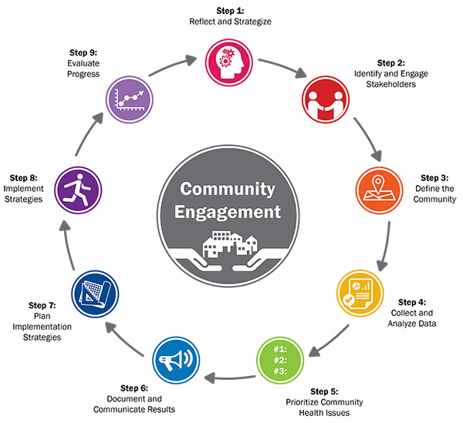
UNDERSTANDING THE POPULATION HEALTH ASSESSMENT PROCESS
What is it?
An evidence-informed process that involves defining and assessing the health status and needs of a community to support community engagement and health system planning.
Why do it?
The assessment serves as the backbone for any population health management strategy. It allows partners to establish a shared understanding of strengths and opportunity areas, to prioritize community needs, and to collaboratively build effective solutions.
Image from Association for Community Health Improvement. 2017. Community Health Assessment Toolkit.
Contact us @ www.healthcommons.ca/contact

