Slide 1
TOOL
Workshop Evaluation Form

Slide 2
IN A NUTSHELL
The voices of community members, patients, health care providers, caregivers and more are essential when working towards health system integration. Workshops are one way to engage with communities and to capture their perspectives. Ensure these voices are heard both during and after the session by evaluating the workshop and incorporating feedback into future events.
What does this tool help you do?
This tool allows you to assess participants’ experiences during a workshop and to collect feedback to support planning of future events. This is important because diverse perspectives are needed to ensure continuous improvement for engagement initiatives.

Slide 3
ABOUT THIS TOOL
What was the tool developed for?
This tool was developed for two OHT community and provider engagement workshops:
Engaging with youth and service providers to understand the community resources that foster youth mental health and wellness
Bringing together front-line providers who serve clients who use substances for a multi-organization staff engagement session.
How did we use it?
At the end of each workshop, participants were asked to provide feedback on their experience to assess how well the workshop met its objectives. We also asked participants for suggestions about future sessions to promote ongoing engagement.

Slide 4
HOW YOU CAN USE THIS TOOL
Edit the evaluation questions to make them your own. Think about what kind of feedback you want to get from participants.
Bring the evaluation results to your next OHT planning meeting! Use them as a tool to understand the perspective.
Share with your partners. Summarize the results and give the group a sense of what is shared and what perspectives stood out.

Slide 5
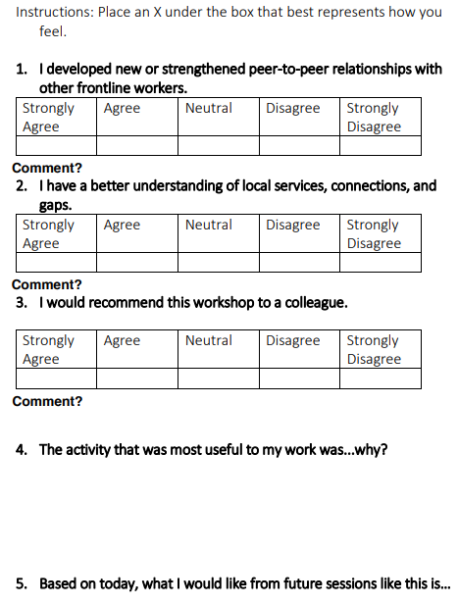
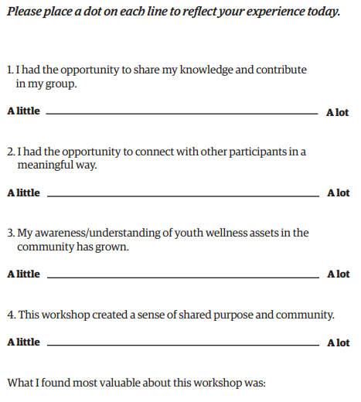
OUR EXAMPLES
x
x
x
Mapping resources in the community.
Sharing resources that are meaningful to me in the community.
More time for informal networking.
Contact us @ www.healthcommons.ca/contact

Slide 6
We would love your feedback! Please place an X under the box that best represents how you feel.
1. I developed new or strengthened peer-to-peer relationships with other frontline workers.
Strongly Agree | Agree | Neutral | Disagree | Strongly Disagree
Comments?
2. I have a better understanding of local services, connections, and gaps.
Strongly Agree | Agree | Neutral | Disagree | Strongly Disagree
Comments?
3. I would recommend this workshop to a colleague.
Strongly Agree | Agree | Neutral | Disagree | Strongly Disagree
Comments?
4. The activity that was most useful to my work was…why?
5. Based on today, what I would like from future sessions like this is…
Contact us @ www.healthcommons.ca/contact
Notes:
Comment?

Slide 7
We would love your feedback! Please place a dot on each line to reflect your experience today.
1. I had the opportunity to share my knowledge and contribute in my group.
A little
A lot
2. I had the opportunity to connect with other participants in a meaningful way.
A little
A lot
3. My awareness/understanding of youth wellness assets in the community has grown.
A little
A lot
4. This workshop created a sense of shared purpose and community.
A little
A lot
What I found most valuable about this workshop was:
Contact us @ www.healthcommons.ca/contact

